Slide 1
Magnetic Levitation with Adjustable Height
Elvin Hajizada
Ali Batuhan Yardım

Slide 2
Project Overview
Magnetic Levitation of Neodymium magnets using Electromagnet
Adjustable height in the range of 1cm
Height is adjusted using potentiometer
Electromagnet is driven by Mosfet (IRFZ44N)
Mosfet is connected to Op Amp PID feedback controller circuit
Position of neodymium magnet is found using data from hall sensor placed under Electromagnet
The magnet can be placed at arbitrary positions within a range of 1 cm via a button

Slide 3
Components Used
Electromagnet
Iron lamented core scrapped from old transformator
Neodymium Magnets
Hall Sensor
Cotroller Circuit Components (Mosfet, Op Amp, potentiometer,resistors, capacitors)
Wood stand

Slide 4
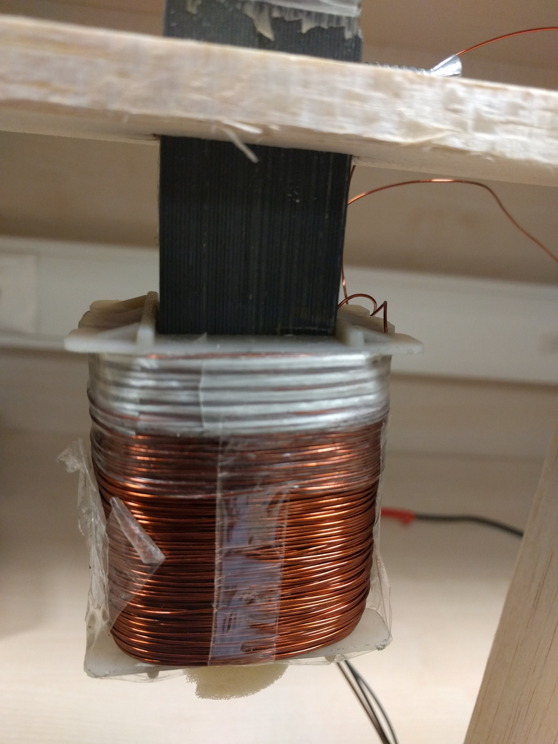
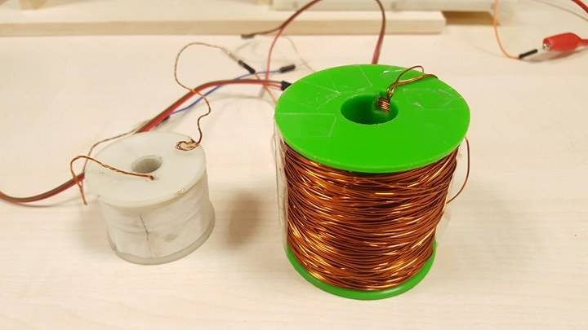
Electromagnet

Slide 5
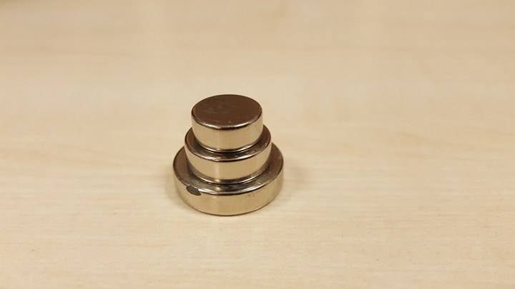
Neodymium Magnets

Slide 6
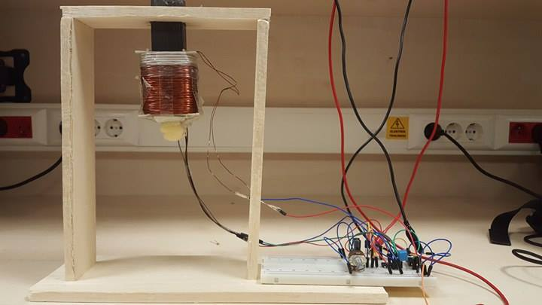
Wood Stand and Entire System

Slide 7
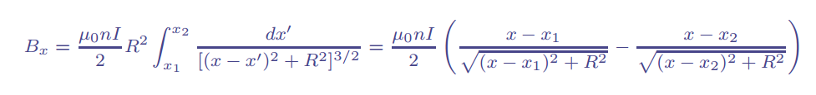
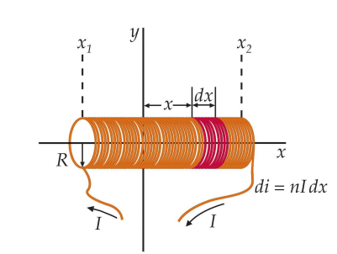
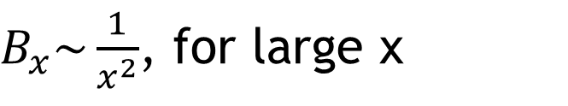
Magnetic flux density
$B_{x}\sim \frac{1}{x^{2}}$, for large x
Force on magnet not linear with distance, the range of
stability is valid within the range of linearization

Slide 8
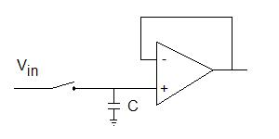
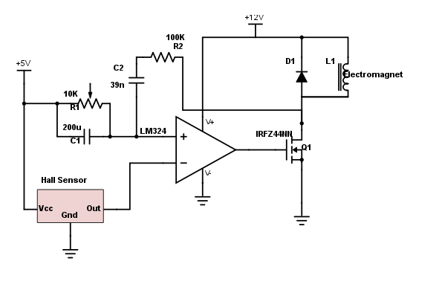
Controller Circuit Schematics
PID based controller
Track and hold circuit

Slide 9
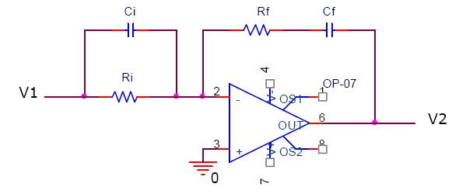
Op Amp PID controller and PID Values
PROPORTIONAL GAIN is Kp = (Rf / Ri + Ci / Cf)
INTEGRAL GAIN is Ki = (1 / RiCf)
DERIVATIVE GAIN is Kd = RfCi.

Slide 10
Future Development
Wider height range
More stable
Modeling of Electromagnet
Nonlinear controller implementing variable PID values
Interactive Levitation

